Slide 1
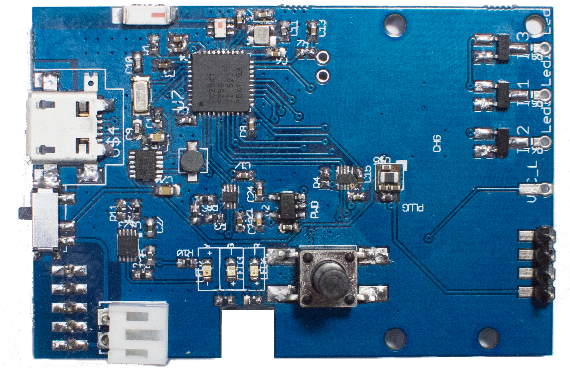
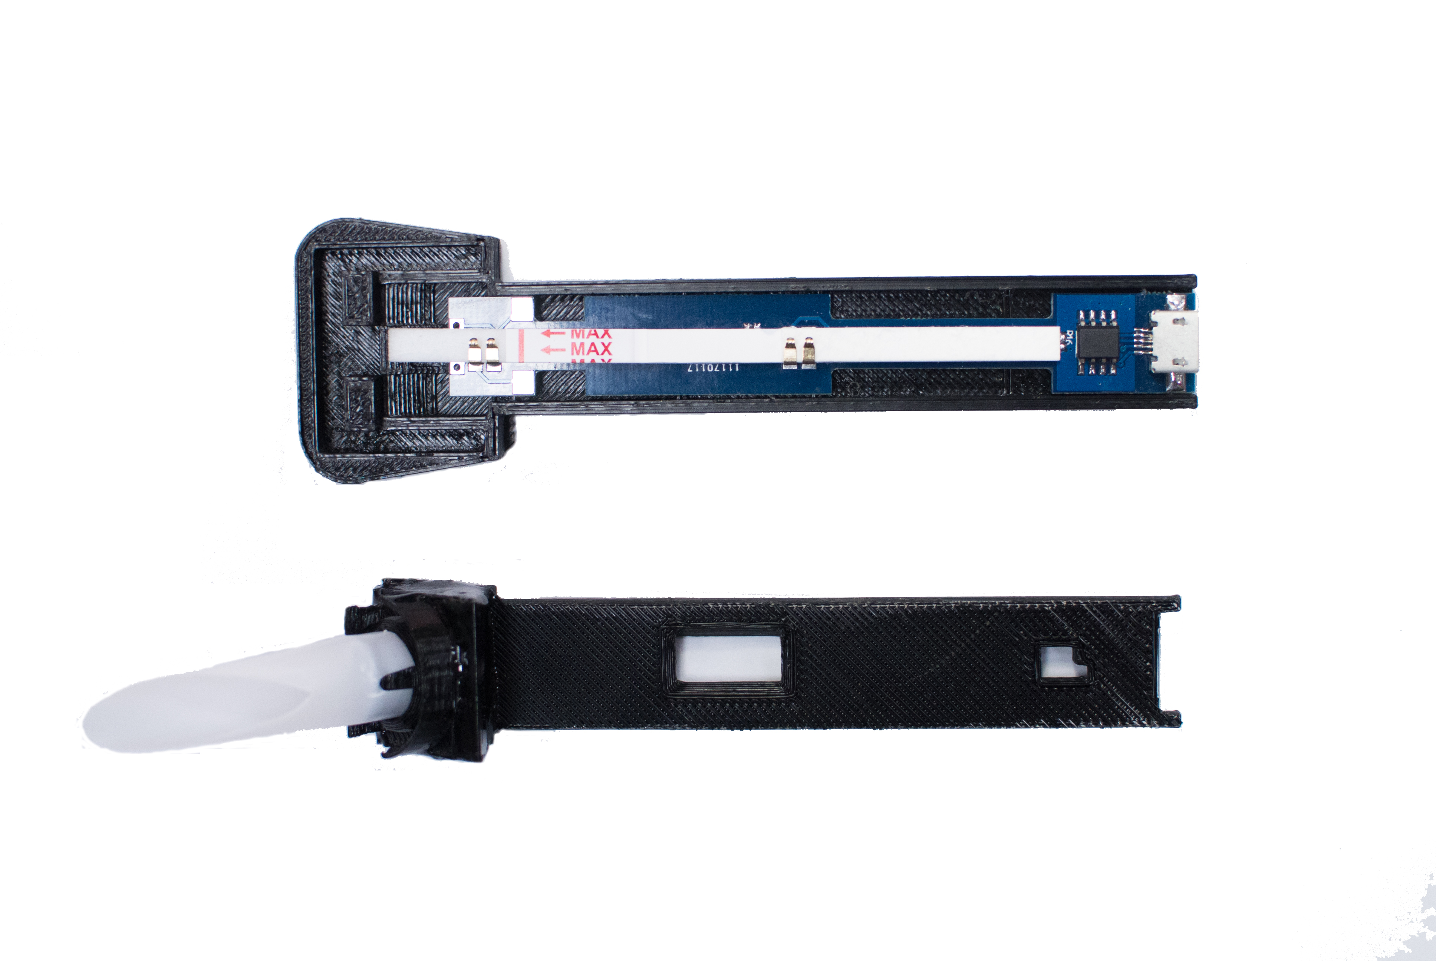
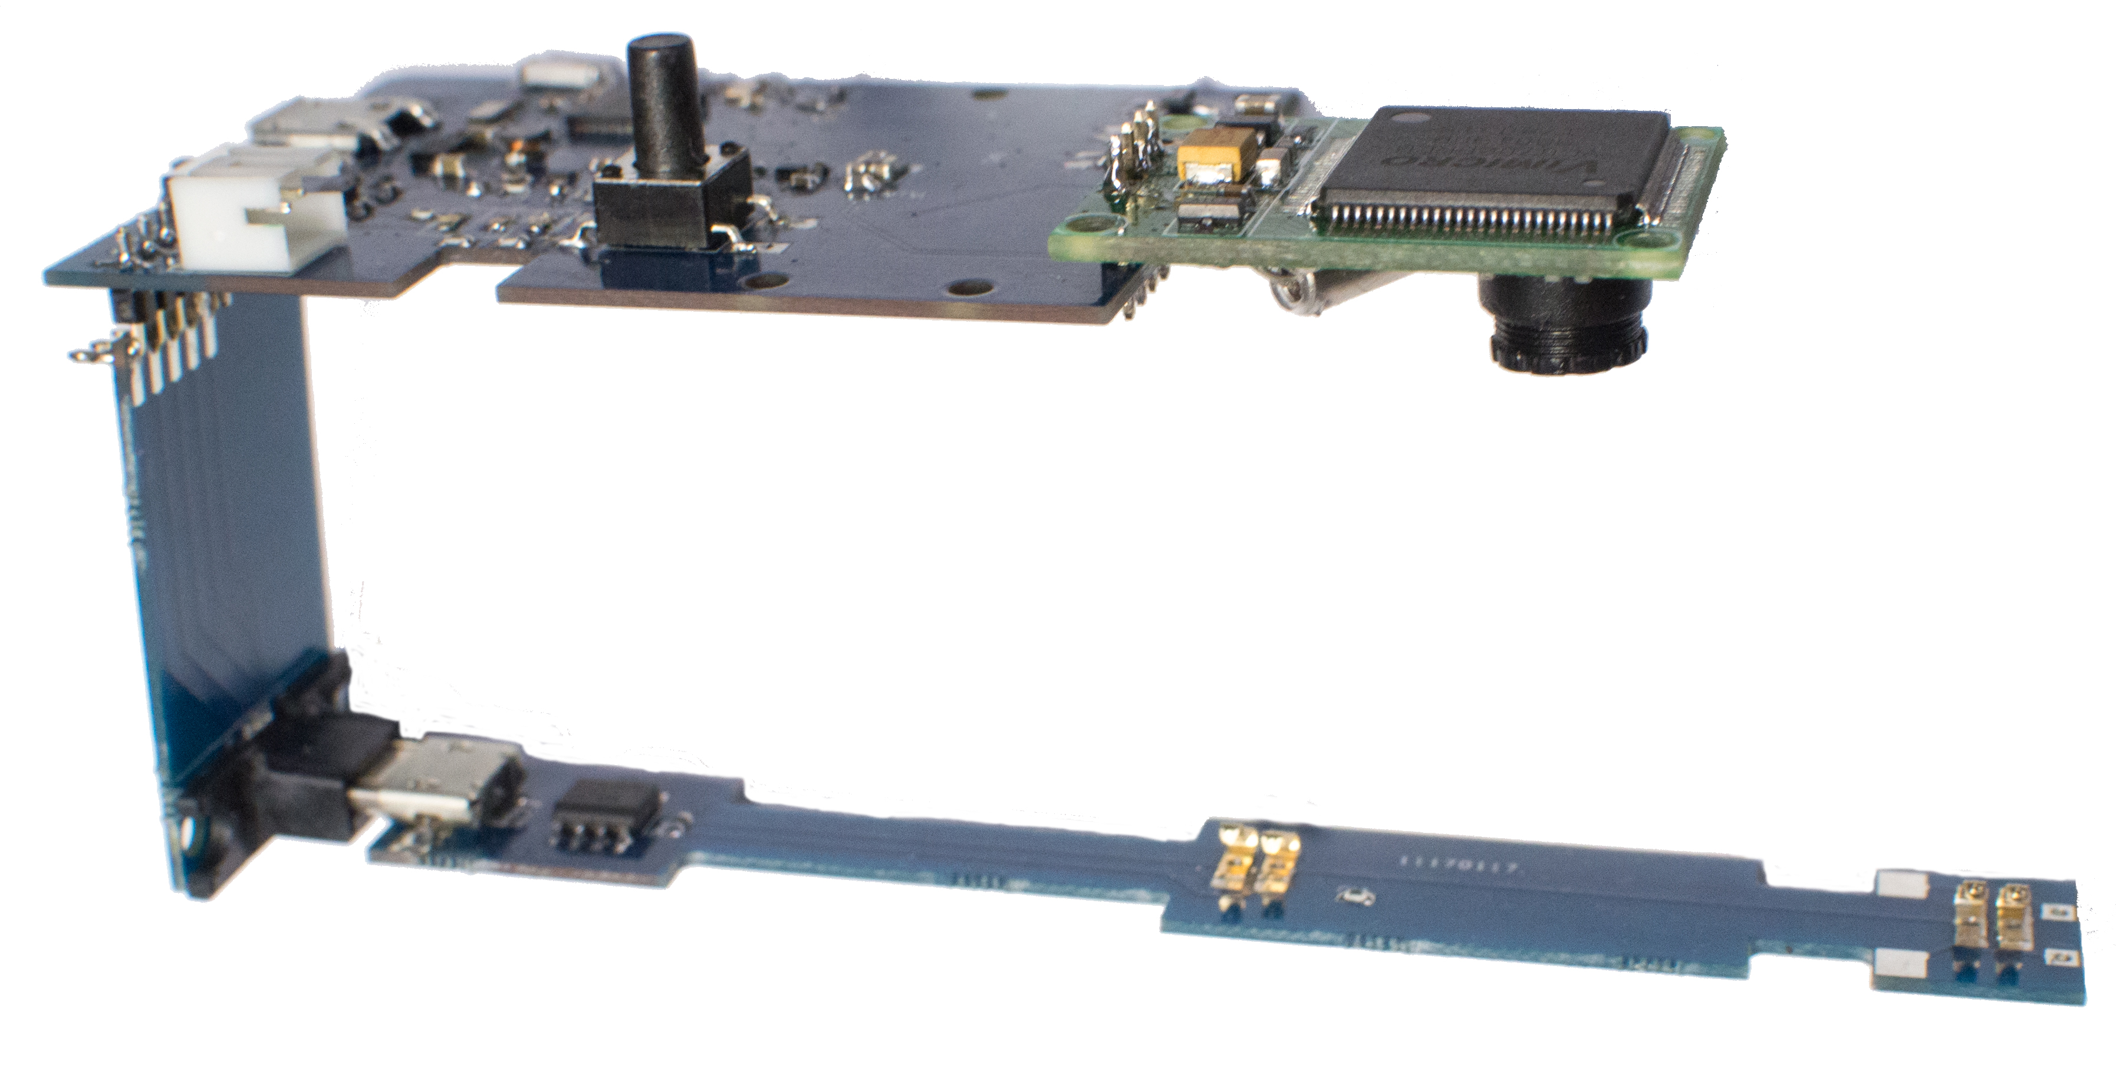
CC2541
MOSFET
AT24C01D
Level shifter
BQ24040
Spring fingers
Indicator LEDs

